Slide 1

BE Project Stage – 2
Title : Smartphone Application for Smooth Path Detection
Guided by:
Prof. Sobha Raskar Prof. Jaya Mane
Presentation by :
Abhishek Gaurav(F17112064)
Prasad Mulherkar (F17112037)
Aniket Patil (F17112046)
Viraj Hinge (F17112065)

Slide 2
Problem Statement :
To detect the bumps, curves and humps on the roads, hence determine the health of the road and finding best path according to the health.

Slide 3
Objective :
Road are becoming Unsafe and Accident prone nowadays because of the bumps and sharp turns, especially during rainy season.
Know the road condition in advance.
So it will be beneficial for the User as well as the Government to identify such routes and repair them as early as possible.

Slide 4
Motivation :
Safety of the rider is dependent upon the quality of the road.
Save a lot of time and money on fuel.
Road quality may be improved if the information is reached to the respective government bodies.

Slide 5
Literature Survey:
Sr No | Title | Study By | Description
1 | Pothole Detection Using Computer Vision and Learning | Amita Dhiman and Reinhard Klette | The study conducted by Amita Dhiman and Reinhard Klette [1] Techniques for identifying potholes on road surfaces aim at developing strategies for real-time or offline identification of potholes, to support real-time control of a vehicle (for driver assistance or autonomous driving) or offline data collection for road maintenance.
2 | IOT based road monitoring system (IoTRMS) | Chellaswamy C | The study conducted by Chellaswamy C [2] an internet of things based road monitoring system (IoTRMS) is proposed to identify the potholes and humps in the road. The IoT-RMS automatically updates the status of the road with location information in the cloud. Each road vehicles can access the information from the server and estimate the speed according to the potholes and humps present on the road.
3 | Creating a real-time Android Application Road Sense that automatically predicts the quality of the road. | Azza Allouch,Anis Koubˆaa, Tarek Abbes, Adel Ammar | The study conducted by Azza Allouch [3] is to create a real-time Android Application RoadSense that automatically predicts the quality of the road based on tri-axial accelerometer and gyroscope, show the road location trace on a geographic map using GPS and save all recorded workout entries. A Decision tree classifier is applied on training data to classify road segments and to build our model.

Slide 6
4 | Using an accelerometer and GPS to analyze the conditions of roads | M. Ghadge | M. Ghadge used an accelerometer and GPS to analyze the conditions of roads to detect locations of potholes and bumps using a machine learning approach, defined by K-means clustering on training data and a random-forest classifier for testing data. The data is divided first into two clusters of “pothole” or “non-pothole”, and then a random forest classifier is used to validate the proposed result provided by the clustering algorithm. It is reported that clustering does not perform well when clusters of different size and severity are involved; size and severity of a pothole are the major properties considered in the system.
5 | Formulation of a Simple Model to Estimate Road Surface Roughness Condition from Android Smartphone Sensors. | Viengnam , Hiroyuki Oneyam | Developed a model to estimate road roughness condition. The analysis which includes matching of data with investigation in frequency domain,proofs that road roughness is linear function of magnitude of acceleration and average speed.
6 | Pothole in the Dark: Perceiving Pothole Profiles with Participatory Urban Vehicles | Guangtao Xue, Hongzi Zhu, Zhenxian Hu, Wen Zhuo | Accessing to timely and accurate road condition information, especially about dangerous potholes is of great importance to the public and the government. In this paper, we propose a novel scheme, called P3, which utilizes smartphones placed in normal vehicles to sense and estimate the profiles of potholes on urban surface roads.In particular, a P3-enabled smartphone can actively learn the knowledge about the suspension system of the host vehicle without any human intervention and adopts a one degree-of-freedom (DOF) vibration model to infer the depth and length of pothole while the vehicle is hitting the pothole.

Slide 7
System Requirements
Hardware Interface Requirements :
Sensors :- Gyroscope, Accelerometer
Android Device
System Requirements :- i5 Processor, 2TB HDD, 8GB RAM
Software Interface Requirements :
JDK 8
Apache Tomcat Server
MySQL Database
Eclipse
Android and Android Studio

Slide 8
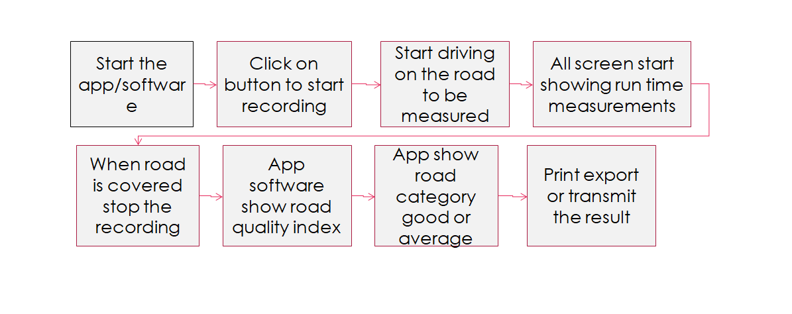
Flow Diagram

Slide 9
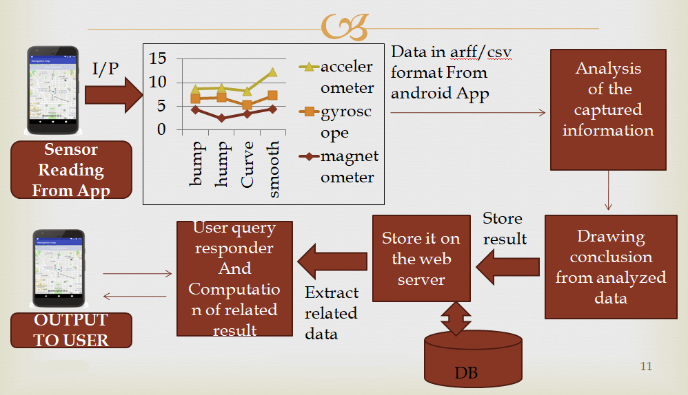
Project implementation

Slide 10
System Architecture
Built a system to tell the user the health of the road while traveling from source to destination.
The system will be integrating app based route determining system on the basis of health of the road.
So basically 3 modules of project are :
Android app
User app
Admin app
Web Server
Database

Slide 11
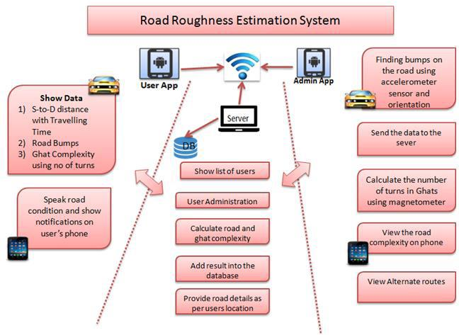
Architecture Diagram

Slide 12
Implemented Algorithm :
K-Means Algorithm :
K-Means is a centroid-based algorithm, or a distance-based algorithm, where we calculate the distances to assign a point to a cluster. In K-Means, each cluster is associated with a centroid.
K-Means is a unsupervised machine learning algorithm, so as our dataset, where we are unable to distinguish between features, labels and noisy data. Hence we are using K-Means clustering algorithm.

Slide 13
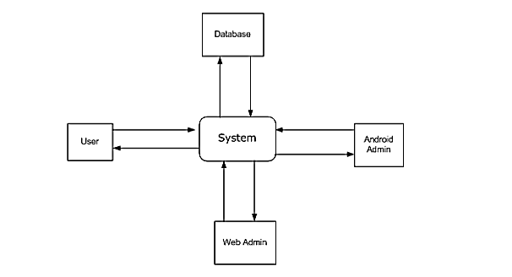
Data Flow Diagram :
LEVEL 0 DFD :

Slide 14
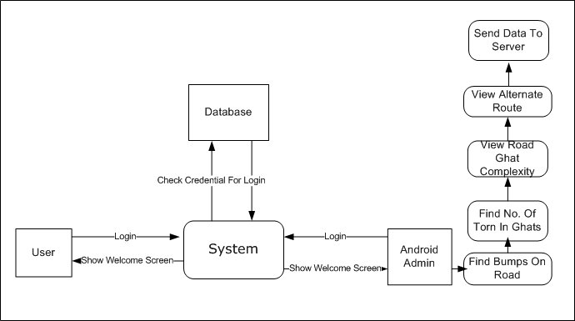
LEVEL 1 DFD :

Slide 15
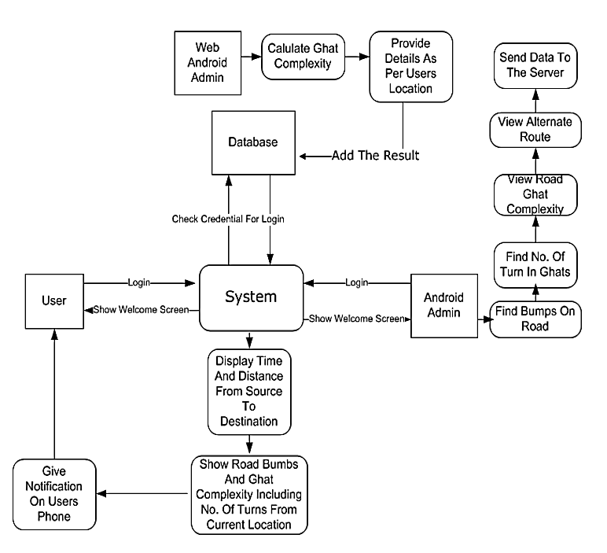
LEVEL 2 DFD :

Slide 16
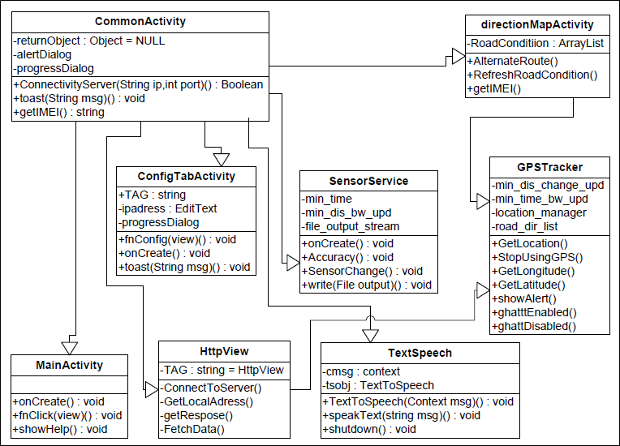
UML Diagrams :
Class Diagram

Slide 17
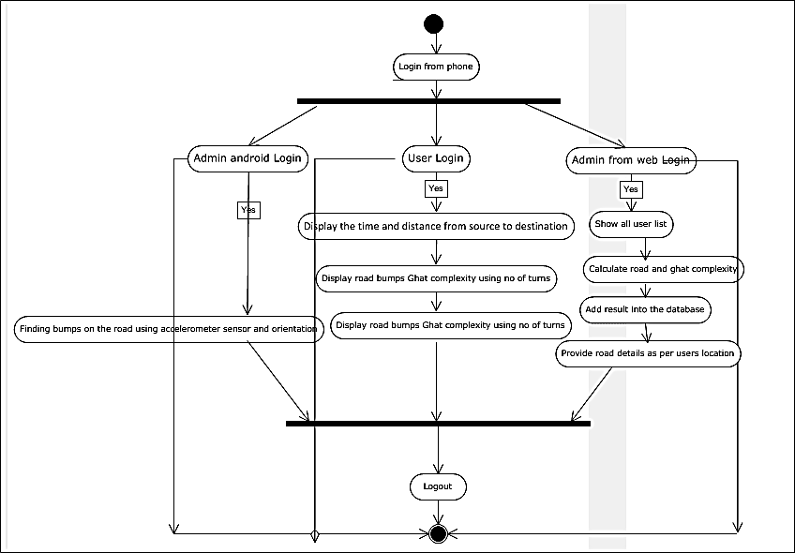
Activity Diagram:

Slide 18
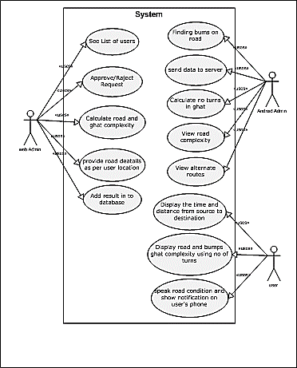
Use Case View

Slide 19
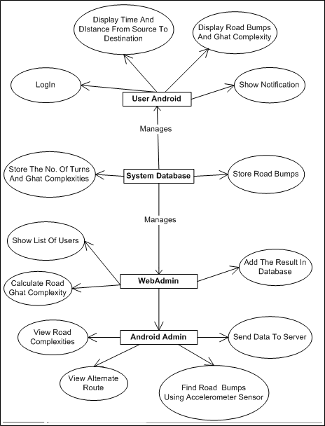
Entity Relationship Diagram

Slide 20
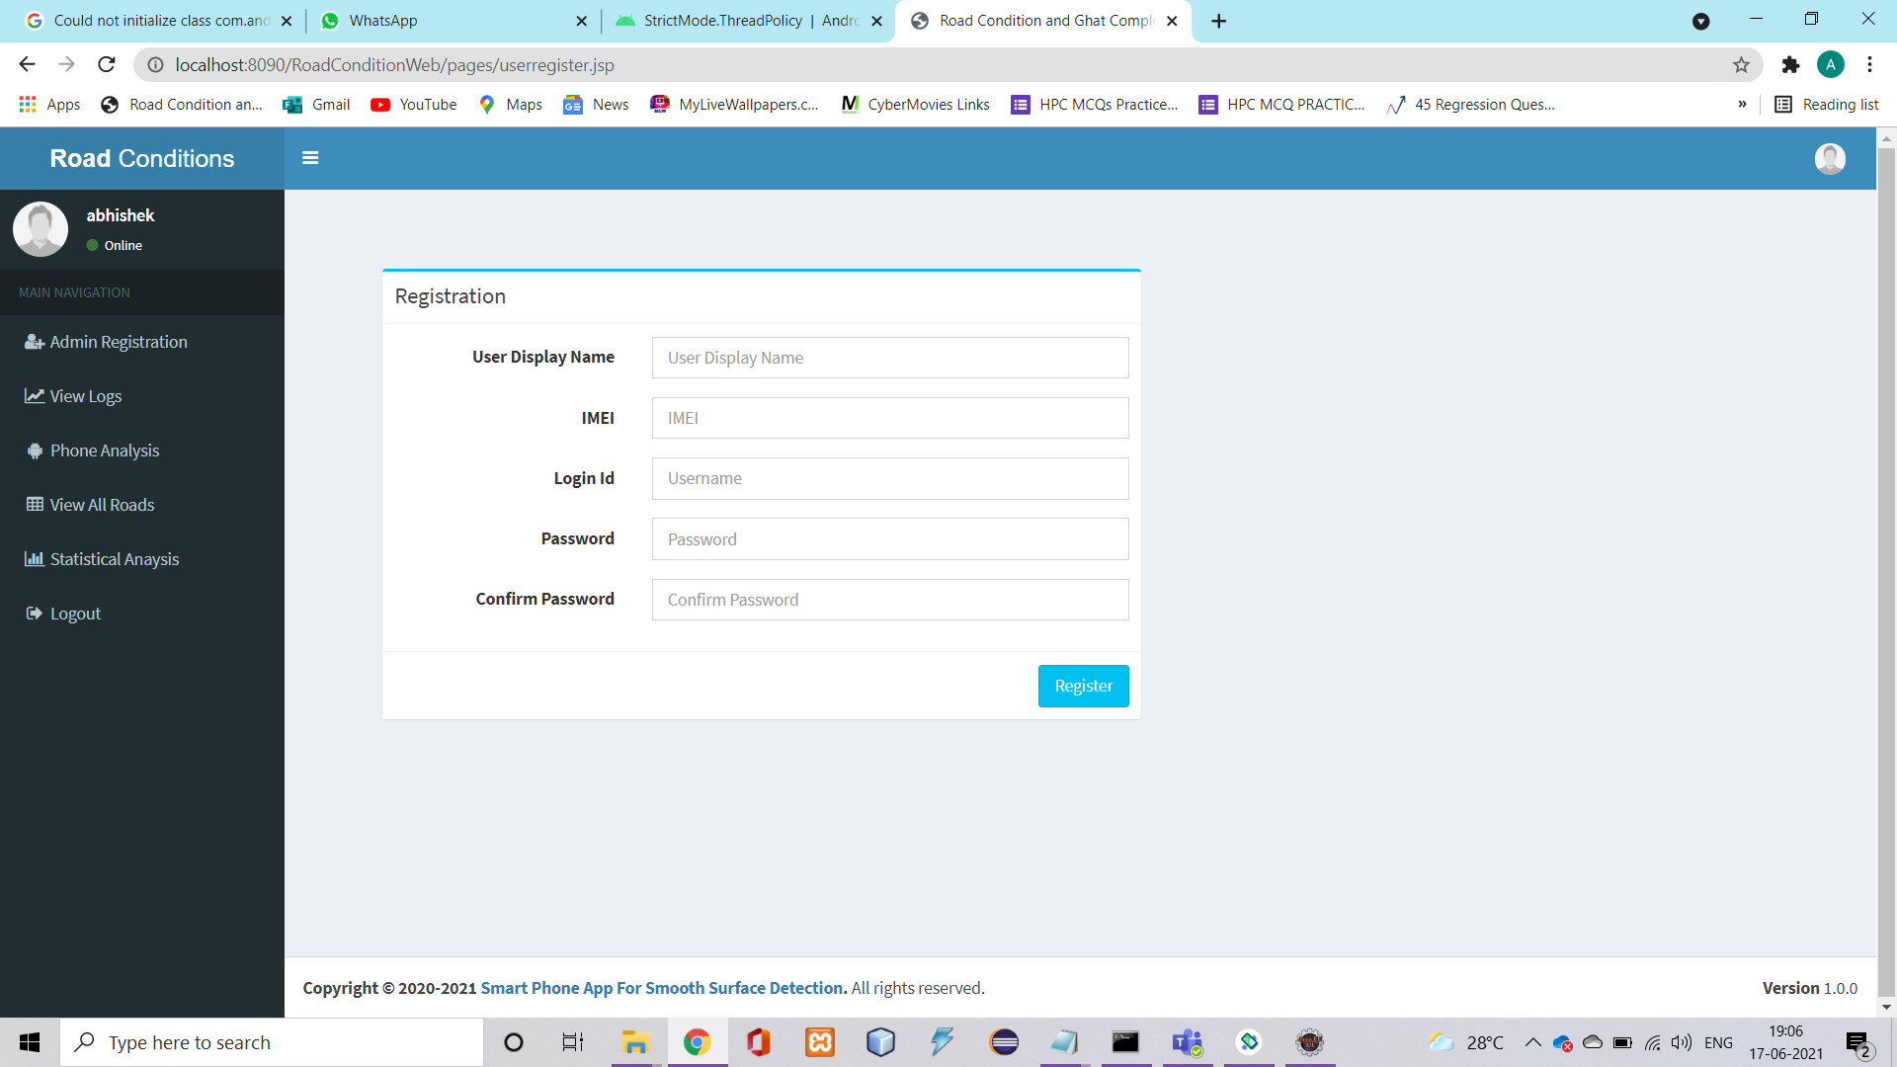
Outputs:
Registration Window

Slide 21
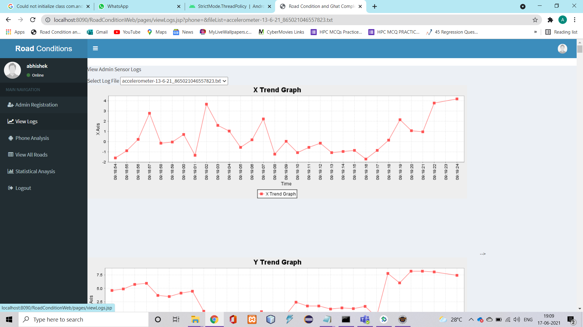
View Log

Slide 22
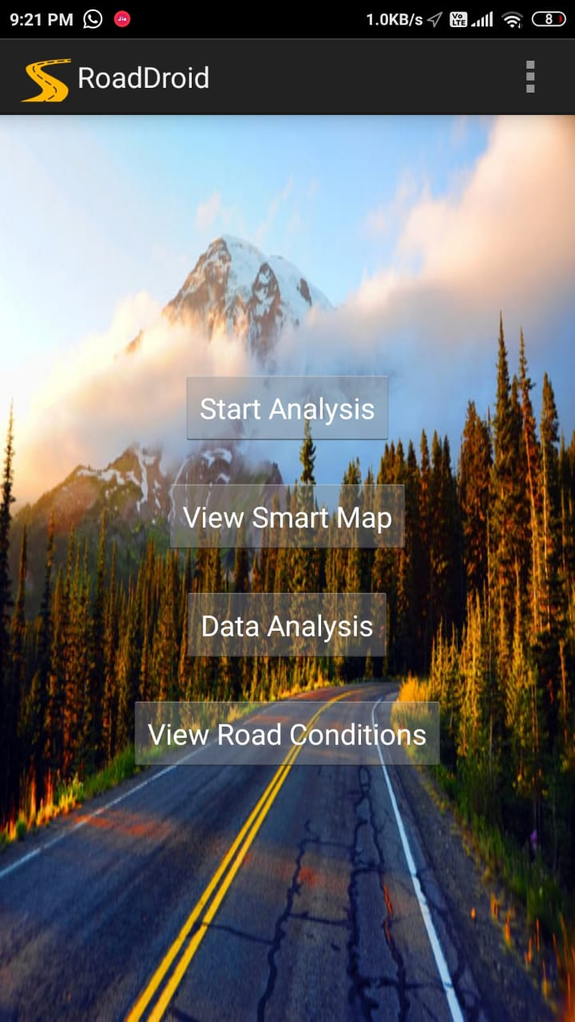

Mobile

Slide 23
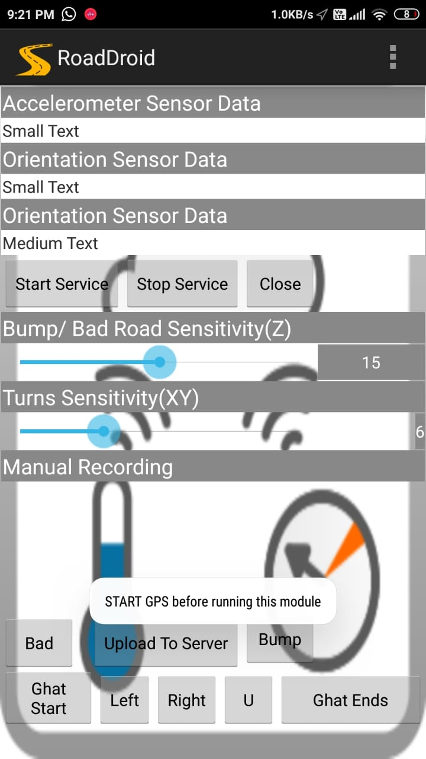
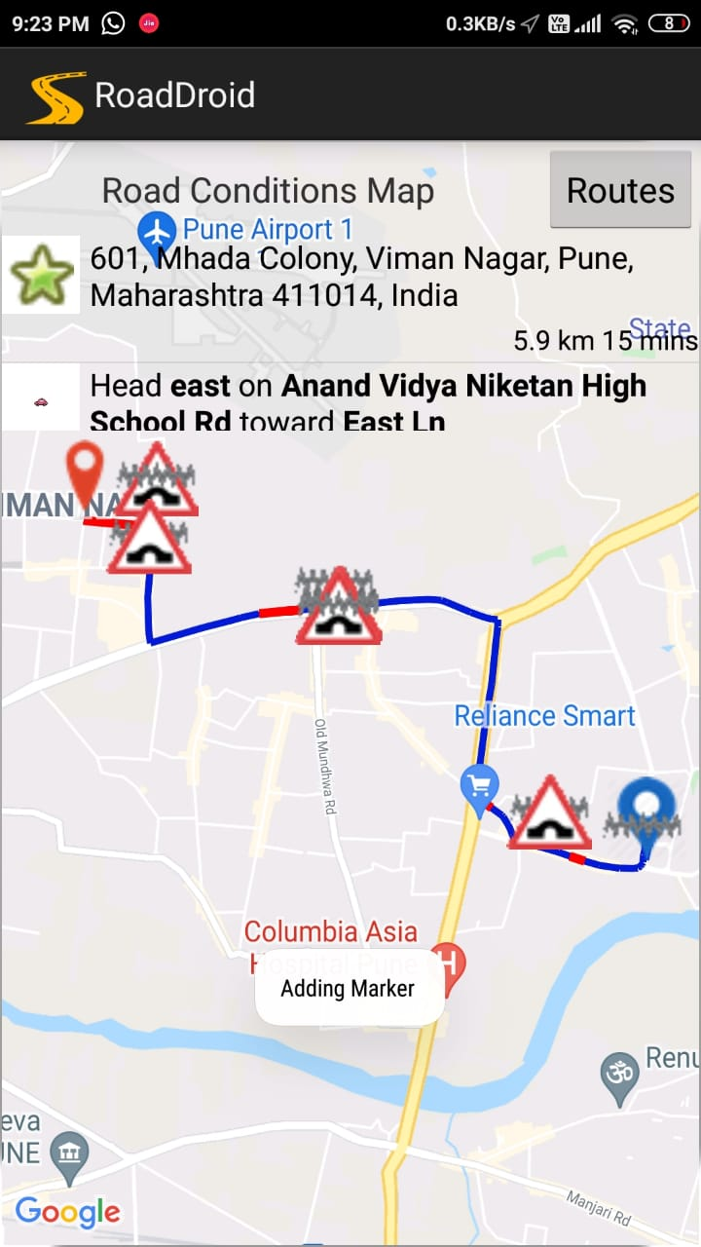
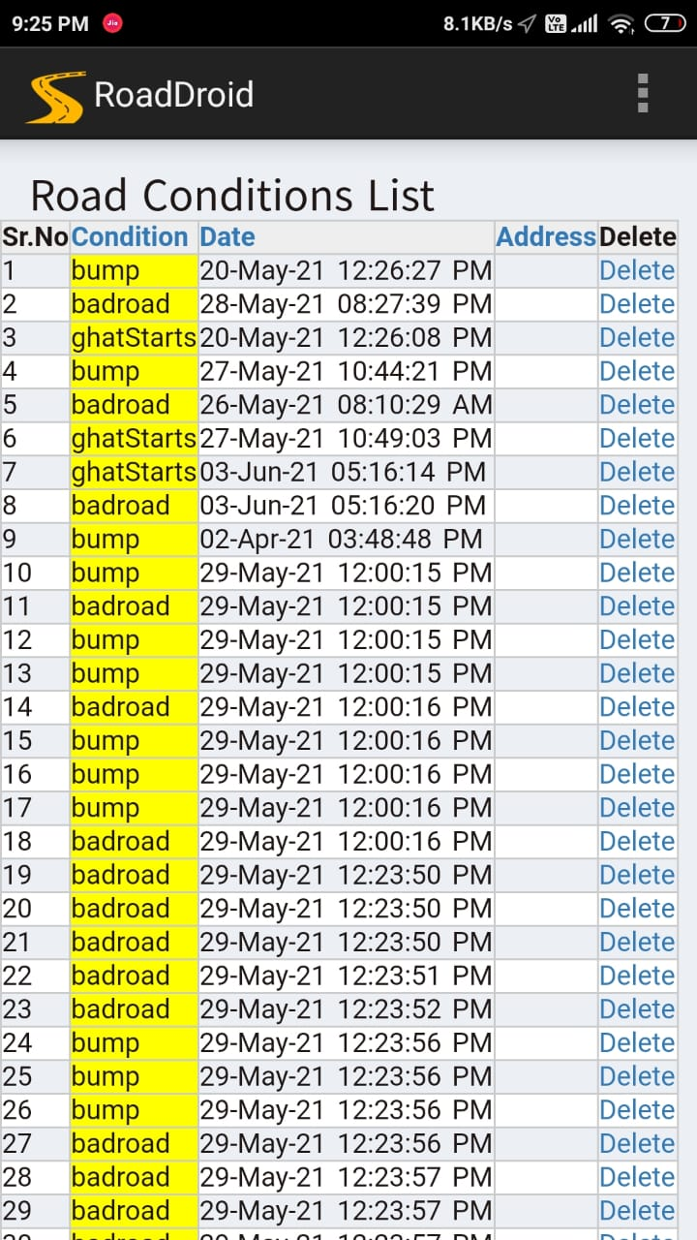

Slide 24
Test cases and test results :
Description | Test Case | Input | Actual Output | Expected Output
Orientation Test 1 | Bump Detection | Positive elevated reading than standard deviation. | Bump | Bump
Orientation Test 2 | Hump Detection | Negative elevated reading than standard deviation. | Hump | Hump
Orientation Test 3 | Bump Detection | Positive elevated reading than standard deviation. | Bump | Normal Road
Orientation Test 4 | Turn Detection | Deflection of Y-axis in North-East | Right Turn | Right Turn
Orientation Test 5 | Turn Detection | Deflection of Y-axis in North-West | Left Turn | Left Turn

Slide 25
Specifications of Project :
ADVANTAGES
This system will help user for faster and safer traveling.
Requires no additional sensors.
Low cost solution with realistic readings.
Accuracy increases every time a new reading comes up for same travelled route.
No predefined orientation required for the Smart-phones.

Slide 26
LIMITATIONS
Less Accuracy.
For uploading data to server, Smart-phone and server should be connected to same network.
Constant GPS tracking needed, which might not be possible in bad network area.
For free access of Google Map API’s we are limited with 20,000 API hit calls..

Slide 27
APPLICATIONS
To navigate from one place to another with the best quality road.
Detect the bumps and humps on traveling route with their precise location.
Detect bad road condition on the route.
Government bodies can notice and repair the roads with very bad quality.

Slide 28
Feasibility And Scope
Feasibility :
As the project doesn’t required any extra gadgets to be installed on vehicle rather use Smartphone sensor like accelerometer which reduces any costs of installation of any extra gadgets on vehicle.
Scope :
It is implemented throughout the city roads to identify accident prone routes which depends on the number of admins who collect the data.

Slide 29
Future work :
In future we will try to reduce the error rate of the existing system for correct road quality estimation. And starting and ending of the route is automatically detected in future.
The system can be upgraded to perform collaborative analysis of road complexity by extracting data from various diverse sources.
The system can be hosted on cloud platform in future to scale it on larger levels.

Slide 30
Publication Details
Paper Title : “SMART PHONE APP FOR SMOOTH PATH DETECTION”
Publication : International Research Journal of Modernization in
Engineering Technology and Science (IRJMETS).
Publication ID : IRJMETS551096
Published in : Volume 3, Issue 1, January 2021

Slide 31
References :
Pothole Detection Using Computer Vision and Learning: Application to detect pothole using accelerometer IEEE transaction 2019
IoT Based Humps and Pothole Detection on Roads and Information Sharing : Application to detect humps using accelerometer IEEE transaction 2018.
Road Sense: Smartphone Application to Estimate Road Conditions using Accelerometer and Gyroscope IEEE transaction 2017.
Road Disturbance Estimation and Cloud-Aided Comfort-Based Route Planning IEEE transaction 2017.
Machine Learning Approach for Predicting Bumps on Road IEEE conference paper 2015.
Formulation of a Simple Model to Estimate Road Surface Roughness Condition from Android Smartphone Sensors conference paper 2017.

